Slide 1
Lecture 18
Dynamic set partitions and the union-find algorithm
EECS-214

Slide 2
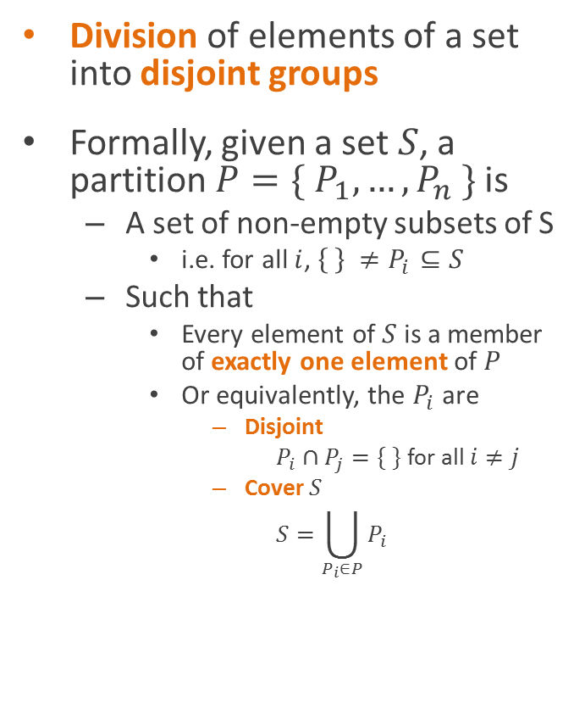
Set partitions
Division of elements of a set into disjoint groups
Formally, given a set $S$, a partition $P=\{ P_{1},…, P_{n} \}$ is
  A set of non-empty subsets of S
    i.e. for all $i$, $\left\{ \right\} ≠P_{i}⊆S$
  Such that
    Every element of $S$ is a member of exactly one element of $P$
    Or equivalently, the $P_{i}$ are
      Disjoint
        $P_{i}∩P_{j}=\{ \}$ for all $i≠j$
      Cover $S$
        $$S=\bigcup_{P_{i}∈P}{P_{i}}$$

Slide 3
Set partitions
Division of elements of a set into disjoint groups
Formally, given a set $S$, a partition $P=\{ P_{1},…, P_{n} \}$ is
  A set of non-empty subsets of S
    i.e. for all $i$, $\left\{ \right\} ≠P_{i}⊆S$
  Such that
    Every element of $S$ is a member of exactly one element of $P$
    Or equivalently, the $P_{i}$ are
      Disjoint
        $P_{i}∩P_{j}=\{ \}$ for all $i≠j$
      Cover $S$
        $$S=\bigcup_{P_{i}∈P}{P_{i}}$$

Slide 4
Set partitions
Division of elements of a set into disjoint groups
Formally, given a set $S$, a partition $P=\{ P_{1},…, P_{n} \}$ is
  A set of non-empty subsets of S
    i.e. for all $i$, $\left\{ \right\} ≠P_{i}⊆S$
  Such that
    Every element of $S$ is a member of exactly one element of $P$
    Or equivalently, the $P_{i}$ are
      Disjoint
        $P_{i}∩P_{j}=\{ \}$ for all $i≠j$
      Cover $S$
        $$S=\bigcup_{P_{i}∈P}{P_{i}}$$

Slide 5
Set partitions
Division of elements of a set into disjoint groups
Formally, given a set $S$, a partition $P=\{ P_{1},…, P_{n} \}$ is
  A set of non-empty subsets of S
    i.e. for all $i$, $\left\{ \right\} ≠P_{i}⊆S$
  Such that
    Every element of $S$ is a member of exactly one element of $P$
    Or equivalently, the $P_{i}$ are
      Disjoint
        $P_{i}∩P_{j}=\{ \}$ for all $i≠j$
      Cover $S$
        $$S=\bigcup_{P_{i}∈P}{P_{i}}$$

Slide 6

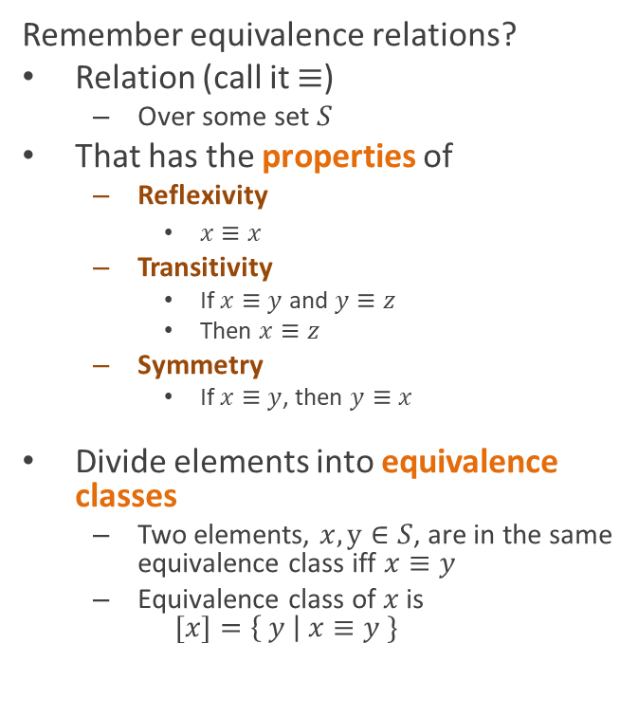
Partitions and equivalence relations
Remember equivalence relations?
Relation (call it $≡$)
  Over some set $S$
That has the properties of
  Reflexivity
    $x≡x$
  Transitivity
    If $x≡y$ and $y≡z$
    Then $x≡z$
  Symmetry
    If $x≡y$, then $y≡x$
Divide elements into equivalence classes
  Two elements, $x, y∈S$, are in the same equivalence class iff $x≡y$
  Equivalence class of $x$ is
  $[x]=\left\{ y \right| x≡y \}$
Partitions and equivalence relations are interchangeable ideas
Equivalence classes form a partition of $S$
Given a partition, we can construct an equivalence relation from it
  $a≡b$ iff $a$ and $b$ are in the same set within the partition

Slide 7
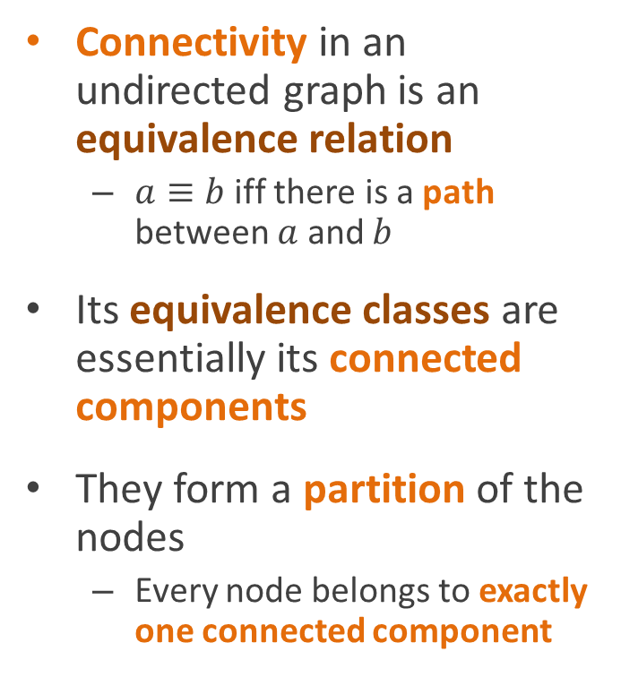
Connected components
Connectivity in an undirected graph is an equivalence relation
  $a≡b$ iff there is a path between $a$ and $b$
Its equivalence classes are essentially its connected components
They form a partition of the nodes
  Every node belongs to exactly one connected component

Slide 8
Connected components
How do we compute the partition?

Slide 9
Connected component analysis using depth-first search
LabelConnectedComponents()
component = 0
for each node in graph
if node not visited
LCCVisit(node, component)
component++
LCCVisit(node, c)
mark node visited
node.component = c
for each unvisited
neighbor, n, of node
LCCVisit(n, c)
1
4
2
3
8
9
11
5
12
6
7

Slide 10
Connected component analysis using depth-first search
LabelConnectedComponents()
component = 0
for each node in graph
if node not visited
LCCVisit(node, component)
component++
LCCVisit(node, c)
mark node visited
node.component = c
for each unvisited
neighbor, n, of node
LCCVisit(n, c)
1
4
2
3
8
9
11
5
12
6
7

Slide 11
Connected component analysis using depth-first search
LabelConnectedComponents()
component = 0
for each node in graph
if node not visited
LCCVisit(node, component)
component++
LCCVisit(node, c)
mark node visited
node.component = c
for each unvisited
neighbor, n, of node
LCCVisit(n, c)
1
4
2
3
8
9
11
5
12
6
7

Slide 12
Connected component analysis using depth-first search
0
LabelConnectedComponents()
component = 0
for each node in graph
if node not visited
LCCVisit(node, component)
component++
LCCVisit(node, c)
mark node visited
node.component = c
for each unvisited
neighbor, n, of node
LCCVisit(n, c)
1
4
2
3
8
9
11
5
12
6
7

Slide 13
Connected component analysis using depth-first search
0
LabelConnectedComponents()
component = 0
for each node in graph
if node not visited
LCCVisit(node, component)
component++
LCCVisit(node, c)
mark node visited
node.component = c
for each unvisited
neighbor, n, of node
LCCVisit(n, c)
1
4
2
3
8
9
11
5
12
6
7

Slide 14
Connected component analysis using depth-first search
0
LabelConnectedComponents()
component = 0
for each node in graph
if node not visited
LCCVisit(node, component)
component++
LCCVisit(node, c)
mark node visited
node.component = c
for each unvisited
neighbor, n, of node
LCCVisit(n, c)
1
4
0
2
3
8
9
11
5
12
6
7

Slide 15
Connected component analysis using depth-first search
0
LabelConnectedComponents()
component = 0
for each node in graph
if node not visited
LCCVisit(node, component)
component++
LCCVisit(node, c)
mark node visited
node.component = c
for each unvisited
neighbor, n, of node
LCCVisit(n, c)
1
4
0
2
0
3
8
9
11
5
12
6
7

Slide 16
Connected component analysis using depth-first search
0
LabelConnectedComponents()
component = 0
for each node in graph
if node not visited
LCCVisit(node, component)
component++
LCCVisit(node, c)
mark node visited
node.component = c
for each unvisited
neighbor, n, of node
LCCVisit(n, c)
1
4
0
2
0
3
8
0
9
11
5
12
6
7

Slide 17
Connected component analysis using depth-first search
0
LabelConnectedComponents()
component = 0
for each node in graph
if node not visited
LCCVisit(node, component)
component++
LCCVisit(node, c)
mark node visited
node.component = c
for each unvisited
neighbor, n, of node
LCCVisit(n, c)
1
4
0
2
0
3
0
8
0
9
11
5
12
6
7

Slide 18
Connected component analysis using depth-first search
0
LabelConnectedComponents()
component = 0
for each node in graph
if node not visited
LCCVisit(node, component)
component++
LCCVisit(node, c)
mark node visited
node.component = c
for each unvisited
neighbor, n, of node
LCCVisit(n, c)
1
0
4
0
2
0
3
0
8
0
9
11
5
12
6
7

Slide 19
Connected component analysis using depth-first search
0
LabelConnectedComponents()
component = 0
for each node in graph
if node not visited
LCCVisit(node, component)
component++
LCCVisit(node, c)
mark node visited
node.component = c
for each unvisited
neighbor, n, of node
LCCVisit(n, c)
1
0
4
0
2
0
3
0
8
0
9
11
5
12
6
7

Slide 20
Connected component analysis using depth-first search
0
LabelConnectedComponents()
component = 0
for each node in graph
if node not visited
LCCVisit(node, component)
component++
LCCVisit(node, c)
mark node visited
node.component = c
for each unvisited
neighbor, n, of node
LCCVisit(n, c)
1
0
4
0
2
0
3
0
8
0
9
11
5
12
6
7

Slide 21
Connected component analysis using depth-first search
0
LabelConnectedComponents()
component = 0
for each node in graph
if node not visited
LCCVisit(node, component)
component++
LCCVisit(node, c)
mark node visited
node.component = c
for each unvisited
neighbor, n, of node
LCCVisit(n, c)
1
0
4
0
2
0
3
0
8
0
9
1
11
5
12
6
7

Slide 22
Connected component analysis using depth-first search
0
LabelConnectedComponents()
component = 0
for each node in graph
if node not visited
LCCVisit(node, component)
component++
LCCVisit(node, c)
mark node visited
node.component = c
for each unvisited
neighbor, n, of node
LCCVisit(n, c)
1
0
4
0
2
0
3
0
8
0
9
1
11
5
12
1
6
7

Slide 23
Connected component analysis using depth-first search
0
LabelConnectedComponents()
component = 0
for each node in graph
if node not visited
LCCVisit(node, component)
component++
LCCVisit(node, c)
mark node visited
node.component = c
for each unvisited
neighbor, n, of node
LCCVisit(n, c)
1
0
4
0
2
0
3
0
8
0
9
1
1
11
5
12
1
6
7

Slide 24
Connected component analysis using depth-first search
0
LabelConnectedComponents()
component = 0
for each node in graph
if node not visited
LCCVisit(node, component)
component++
LCCVisit(node, c)
mark node visited
node.component = c
for each unvisited
neighbor, n, of node
LCCVisit(n, c)
1
0
4
0
2
0
3
0
8
0
9
1
1
11
5
12
1
1
6
7

Slide 25
Connected component analysis using depth-first search
0
LabelConnectedComponents()
component = 0
for each node in graph
if node not visited
LCCVisit(node, component)
component++
LCCVisit(node, c)
mark node visited
node.component = c
for each unvisited
neighbor, n, of node
LCCVisit(n, c)
1
0
4
0
2
0
3
0
8
0
9
1
1
11
5
12
1
1
6
7

Slide 26
Connected component analysis using depth-first search
0
LabelConnectedComponents()
component = 0
for each node in graph
if node not visited
LCCVisit(node, component)
component++
LCCVisit(node, c)
mark node visited
node.component = c
for each unvisited
neighbor, n, of node
LCCVisit(n, c)
1
0
4
0
2
0
3
0
8
0
9
1
1
11
5
12
1
1
6
7

Slide 27
Connected component analysis using depth-first search
0
LabelConnectedComponents()
component = 0
for each node in graph
if node not visited
LCCVisit(node, component)
component++
LCCVisit(node, c)
mark node visited
node.component = c
for each unvisited
neighbor, n, of node
LCCVisit(n, c)
1
0
4
0
2
0
3
0
8
0
9
1
1
11
5
2
12
1
1
6
7

Slide 28
Testing if two nodes are connected
0
This lets us test connectivity in constant time
Just look up the component numbers of the two nodes
And check if they’re the same
1
0
4
0
2
0
3
0
8
0
9
1
1
11
5
2
12
1
1
6
7

Slide 29
Testing if two nodes are connected
0
Oh, your boss called
They want to add an edge
You don’t mind do you?
1
0
4
0
2
0
3
0
8
0
9
1
1
11
5
2
12
1
1
6
7

Slide 30
Testing if two nodes are connected
0
Oh, your boss called
They want to add an edge
You don’t mind do you?
Now we have to rerun the whole analysis
1
0
4
0
2
0
3
0
8
0
9
1
1
11
5
2
12
1
1
6
7

Slide 31
Dynamic set partition algorithms
0
How do we modify this to allow us to incrementally merge equivalence classes?
1
0
4
0
2
0
3
0
8
0
9
1
1
11
5
2
12
1
1
6
7

Slide 32
Dynamic set partition algorithms
0
Basic idea:
Remember that component 0 is “really” component 1
1
0
4
0
2
0
3
0
8
0
9
1
1
11
5
2
12
1
1
6
7

Slide 33
Dynamic set partition algorithms
0
Basic idea:
Remember that component 0 is “really” component 1
Then don’t compare the component numbers directly
Compare the “real” component numbers
1
0
4
0
2
0
3
0
8
0
9
1
1
11
5
2
12
1
1
6
7

Slide 34
Dynamic set partition algorithms
0
Example:
Node 1 and node 11 are connected
  Because node 1 is in component 0
  But component 0 is really component 1
  And node 11 is also in component 1
1
0
4
0
2
0
3
0
8
0
9
1
1
11
5
2
12
1
1
6
7

Slide 35
Computing connected components
In fact, we can use this idea to replace the depth-first search entirely
And compute the connected components incrementally
Note: this is going to be hand-wavy, but we’ll make the algorithms precise later
1
4
2
3
8
9
11
5
12
6
7

Slide 36
Computing connected components
Here’s the idea
1
4
2
3
8
9
11
5
12
6
7

Slide 37
Computing connected components
Here’s the idea
Start by assuming every node is in its own connected component
1
4
2
3
8
9
11
5
12
6
7

Slide 38
Computing connected components
Here’s the idea
Start by assuming every node is in its own connected component
Pick an edge
1
4
2
3
8
9
11
5
12
6
7

Slide 39
Computing connected components
Here’s the idea
Start by assuming every node is in its own connected component
Pick an edge
Merge the components of the two nodes
  By remembering that one
  Is in the component of the other
1
4
2
3
8
9
11
5
12
6
7

Slide 40
Computing connected components
Pick another edge
1
4
2
3
8
9
11
5
12
6
7

Slide 41
Computing connected components
Pick another edge
Merge again
1
4
2
3
8
9
11
5
12
6
7

Slide 42
Computing connected components
Now we have that
  1 is really in 4’s component
  3 is really in 2’s component
1
4
2
3
8
9
11
5
12
6
7

Slide 43
Computing connected components
Pick another edge
1
4
2
3
8
9
11
5
12
6
7

Slide 44
Computing connected components
Pick another edge
Merge again
  4 is now in 2’s component
  But 1 is in 4’s component
  So really, 1, 3, and 4 are all in 2’s component
1
4
2
3
8
9
11
5
12
6
7

Slide 45
Computing connected components
Keep doing this
1
4
2
3
8
9
11
5
12
6
7

Slide 46
Computing connected components
Keep doing this
And we end up with arrows
From all the nodes in a connected component
1
4
2
3
8
9
11
5
12
6
7

Slide 47
Computing connected components
Keep doing this
And we end up with arrows
From all the nodes in a connected component
Flowing to a single node in each component
1
4
2
3
8
9
11
5
12
6
7

Slide 48
Computing connected components
Keep doing this
And we end up with arrows
From all the nodes in a connected component
Flowing to a single node in each component
These are called the representatives of the components
1
4
2
3
8
9
11
5
12
6
7

Slide 49
Computing connected components
Each component forms a tree
With arrows pointing from children to parents
With the representative as its root
So they collectively form a forest
1
4
2
3
8
9
11
5
12
6
7

Slide 50
Computing connected components
To decide if two nodes are connected
1
4
2
3
8
9
11
5
12
6
7

Slide 51
Computing connected components
To decide if two nodes are connected
Follow the arrows to their representatives
  Easy to do because each node only has one edge pointing out
  Except representatives, who have none
Check if they have the same representative
1
4
2
3
8
9
11
5
12
6
7

Slide 52
Computing connected components
The cool thing is
To merge two components
1
4
2
3
8
9
11
5
12
6
7

Slide 53
Computing connected components
The cool thing is
To merge two components
All we have to do is add a pointer
  From one component’s representative
  To the other’s
1
4
2
3
8
9
11
5
12
6
7

Slide 54
Computing connected components
The cool thing is
To merge two components
All we have to do is add a pointer
  From one component’s representative
  To the other’s
Now they both have the same representative
1
4
2
3
8
9
11
5
12
6
7

Slide 55
The union-find algorithm
This is a handwavy version of a general algorithm
Called the union-find algorithm
For working with partitions of sets
1
4
2
3
8
9
11
5
12
6
7

Slide 56
The union-find algorithm
class SetElement {
SetElement parent;
}
Each connected component forms a tree
  With the representative as its root
Keep a parent pointer for each element of the set
  Points to its parent in the tree
  Representatives are roots, so parent is null
    Or it’s often set to itself
    Which saves some work later
Note: we don’t need any child pointers
  Because we will only move upward in the trees
1
4
2
3
8
9
11
5
12
6
7

Slide 57
The union-find algorithm
We start with all the elements in their own groups in the partition
1
4
2
3
8
9
11
5
12
6
7

Slide 58
The union-find algorithm
We start with all the elements in their own groups in the partition
So they’re all their own representatives
1
4
2
3
8
9
11
5
12
6
7

Slide 59
The union-find algorithm
To union (merge) two groups together
1
4
2
3
8
9
11
5
12
6
7

Slide 60
The union-find algorithm
To union (merge) two groups together
Just make the representative of one
Be the parent of the representative of the other
1
4
2
3
8
9
11
5
12
6
7

Slide 61
The union-find algorithm
To union (merge) two groups together
Just make the representative of one
Be the parent of the representative of the other
1
4
2
3
8
9
11
5
12
6
7

Slide 62
The union-find algorithm
To union (merge) two groups together
Just make the representative of one
Be the parent of the representative of the other
1
4
2
3
8
9
11
5
12
6
7

Slide 63
The union-find algorithm
To union (merge) two groups together
Just make the representative of one
Be the parent of the representative of the other
1
4
2
3
8
9
11
5
12
6
7

Slide 64
The union-find algorithm
To union (merge) two groups together
Just make the representative of one
Be the parent of the representative of the other
1
4
2
3
8
9
11
5
12
6
7

Slide 65
The union-find algorithm
To union (merge) two groups together
Just make the representative of one
Be the parent of the representative of the other
1
4
2
3
8
9
11
5
12
6
7

Slide 66
The union-find algorithm
(slow version)
// Find the representative
// for e’s group
Find(SetElement e) {
while (e.parent != null)
e = e.parent;
return e;
}
// Merge the groups of a
// and b together
Union(SetElement a, SetElement b)
{
ar = Find(a);
br = Find(b);
if (ar != br)
ar.parent = br;
}

Slide 67
Complexity analysis
// Find the representative
// for e’s group
Find(SetElement e) {
while (e.parent != null)
e = e.parent;
return e;
}
// Merge the groups of a
// and b together
Union(SetElement a, SetElement b)
{
ar = Find(a);
br = Find(b);
if (ar != br)
ar.parent = br;
}

Slide 68


Complexity analysis
// Find the representative
// for e’s group
Find(SetElement e) {
while (e.parent != null)
e = e.parent;
return e;
}
// Merge the groups of a
// and b together
Union(SetElement a, SetElement b)
{
ar = Find(a);
br = Find(b);
if (ar != br)
ar.parent = br;
}
$$O(h)$$
$$O(h)$$
The worst-case running time of each algorithm is the height of the tree

Slide 69


Complexity analysis
// Find the representative
// for e’s group
Find(SetElement e) {
while (e.parent != null)
e = e.parent;
return e;
}
// Merge the groups of a
// and b together
Union(SetElement a, SetElement b)
{
ar = Find(a);
br = Find(b);
if (ar != br)
ar.parent = br;
}
$$O(n)$$
$$O(n)$$
But the worst-case height of the tree is the number of nodes :-(

Slide 70
How do we make it better?

Slide 71
How do we make it better?
Balance the tree!
Keep track of the heights of the trees
Always add the shorter one to the bigger one

Slide 72
Union by rank (height)
class SetElement {
SetElement parent;
int rank;
}
Union(SetElement a, SetElement b)
{
ar = Find(a);
br = Find(b);
if (ar == br) return;
if (ar.rank < br.rank)
ar.parent = br;
else if (ar.rank > br.rank)
br.parent = ar;
else {
br.parent = ar;
ar.rank = ar.rank + 1;
}

Slide 73
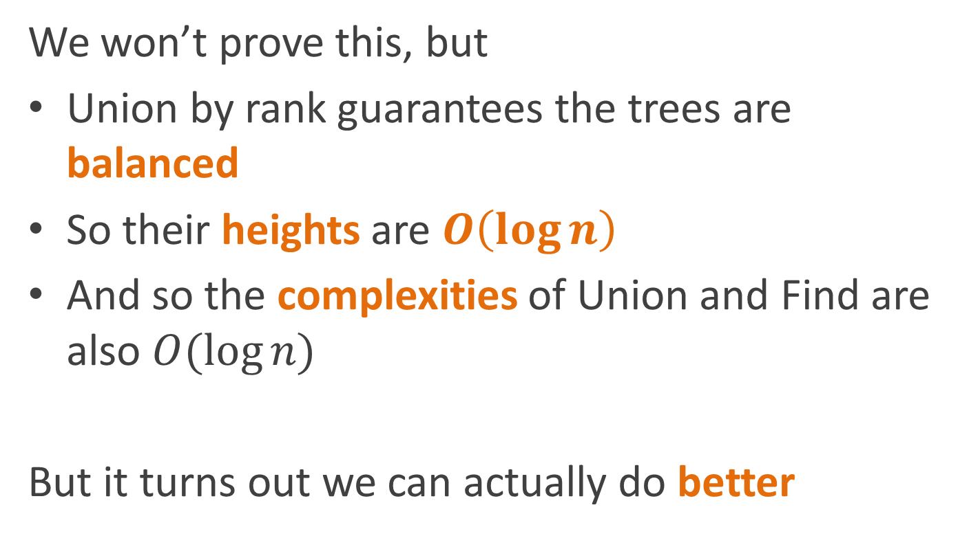
Complexity
We won’t prove this, but
Union by rank guarantees the trees are balanced
So their heights are $O\left(\log{n}\right)$
And so the complexities of Union and Find are also $O(\log{n})$
But it turns out we can actually do better

Slide 74
Saving redundant work
If we call Find on the same node twice
We run up the chain twice
Why not cache the original result?

Slide 75
Path compression
Just update the parent of the element
To point directly at the representative
And while you’re at it, update all the nodes on the path to the representative too!
Find(SetElement a) {
if (a.parent == null)
return a;
a.parent = Find(a.parent);
return a.parent;
}

Slide 76

Complexity analysis
The bad news is that Find is still $O\left(\log{n}\right)$ in the worst case
So what’s the good news?

Slide 77
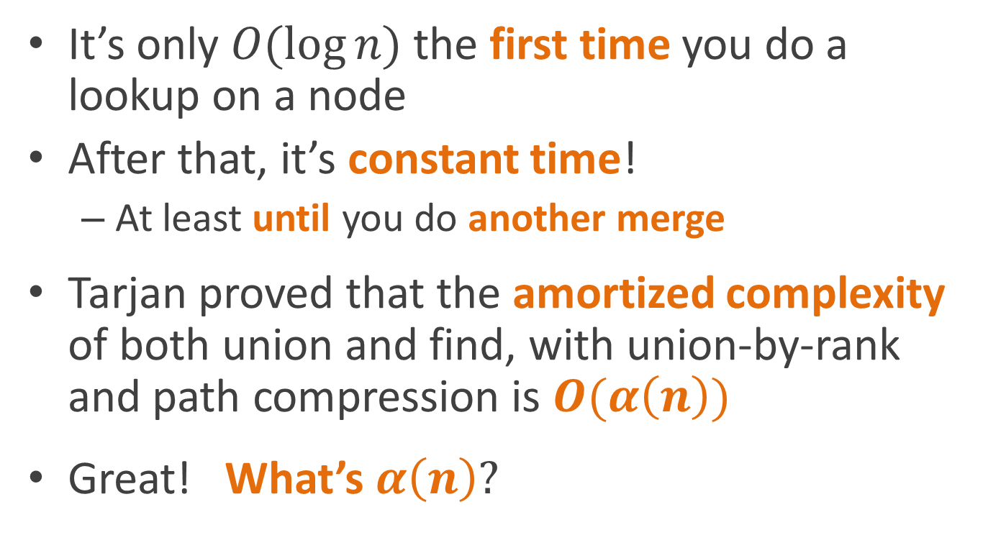
Amortized complexity analysis
It’s only $O(\log{n})$ the first time you do a lookup on a node
After that, it’s constant time!
  At least until you do another merge
Tarjan proved that the amortized complexity of both union and find, with union-by-rank and path compression is $O(α\left(n\right))$
Great! What’s $α\left(n\right)?$

Slide 78

The Ackermann function
Well, there’s this function called the Ackermann function…
$$A\left(m, n\right)= \left\{\begin{matrix}n+1, & \text{if} m=0 \\ A\left(m−1,1\right), & \text{if} m>0 \text{and} n=0 \\ A\left(m−1, A\left(m, n−1\right)\right), & \text{otherwise}\end{matrix}\right.$$

Slide 79
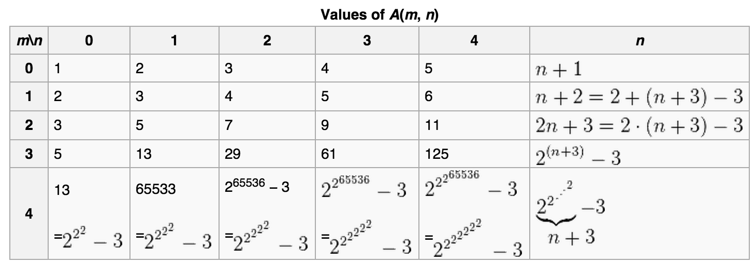
The Ackermann function
Here’s Wikipedia’s table of values for Ackermann’s function:
It grows really really fast.

Slide 80

The inverse Ackermann function
$α(n)$ is the inverse of $A(n,n)$
It grows really really slowly

Slide 81

The inverse Ackermann function
It grows comically slowly
$α\left(\text{the} \text{number} \text{of} \text{subatomic} \text{particles} \text{in} \text{the} \text{universe}\right)<4$
Estimated number of subatomic particles $≅{10}^{80}≅2^{265}$

Slide 82
The inverse Ackermann function
Did I mention it grows slowly?

Slide 83
The inverse Ackermann function
So slowly that it might as well be constant

Slide 84

Amortized complexity analysis
Tarjan proved that the amortized complexity of both union and find is $O(α\left(n\right))$
So for all practical purposes, it’s $O(1)$
That’s pretty cool

Slide 85
Incremental connected components
Add parent and rank fields to each node
Compute the representatives
  For each edge (u,v)
  Union(u, v)
To test connectivity of two nodes, check
Find(u) == Find(v)
1
4
2
3
8
9
11
5
12
6
7

Slide 86


Amortized complexity
For each edge (u,v)
Union(u, v)
To test whether two nodes are connected check
Find(u) == Find(v)
1
$$O(α\left(V\right)E)≅O(E)$$
4
2
3
8
$$O(α\left(V\right))≅O(1)$$
9
11
5
12
6
7

Slide 87

Amortized complexity
For each edge (u,v)
Union(u, v)
To test whether two nodes are connected check
Find(u) == Find(v)
So we can compute connected components incrementally and still do it in linear time
1
$$O(α\left(V\right)E)≅O(E)$$
4
2
3
8
$$O(α\left(V\right))≅O(1)$$
9
11
5
12
6
7

Slide 88
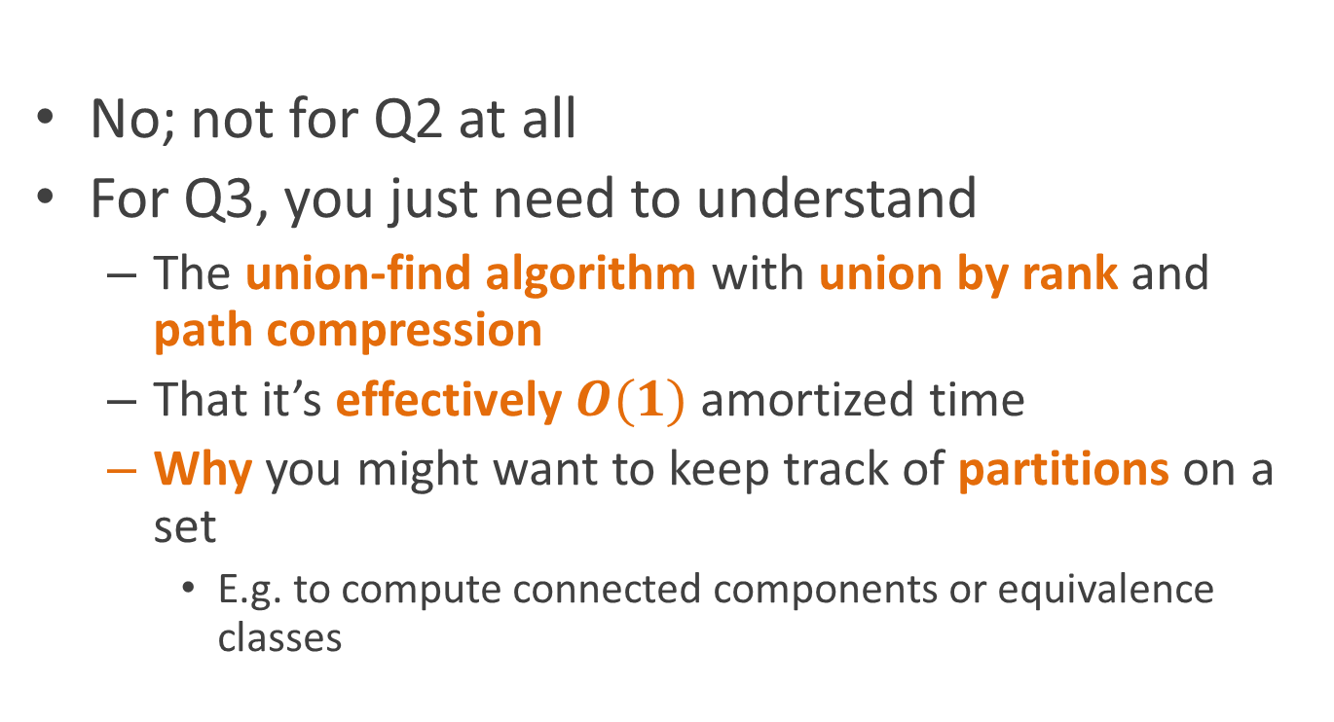
Oh crap! I don’t understand the Ackermann function at all! Do I need to know this for the quiz??!?!?
No; not for Q2 at all
For Q3, you just need to understand
  The union-find algorithm with union by rank and path compression
  That it’s effectively $O(1)$ amortized time
  Why you might want to keep track of partitions on a set
    E.g. to compute connected components or equivalence classes

Slide 89
Reading
Read Chapter 21, sections 1-3

